Slide 1
Machine Learning
A comprehensive overview
Marcel van Velzen
Junior Marte Garcia

Slide 2
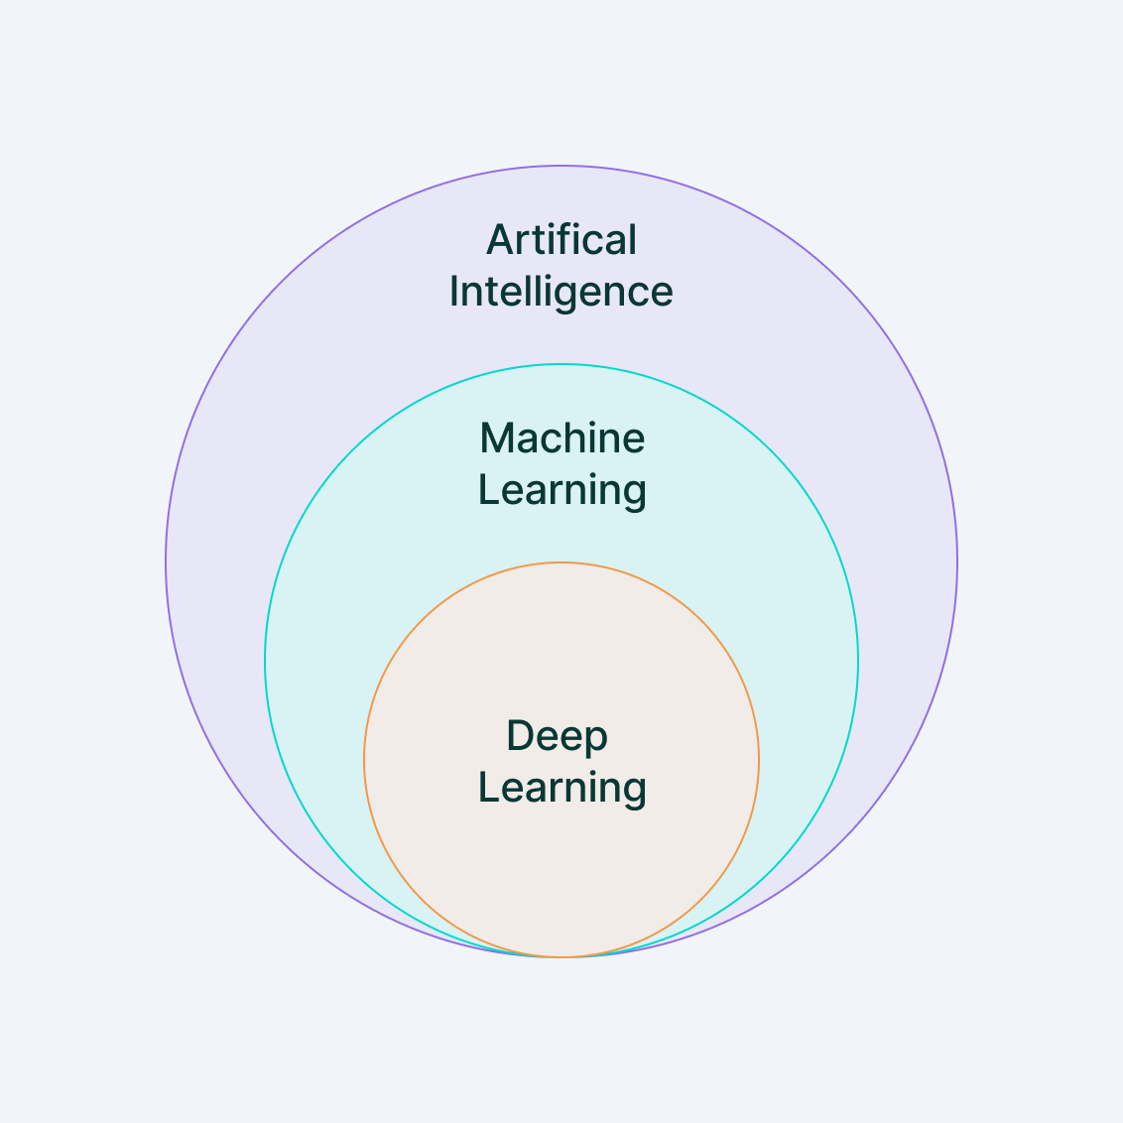
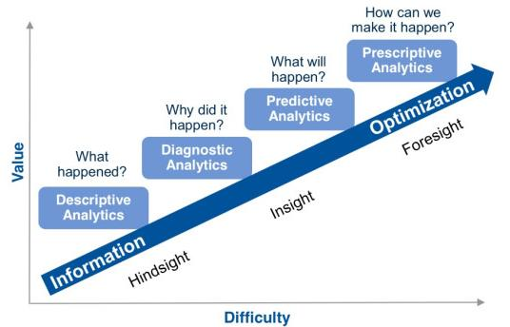
Definition
Machine learning is a branch of artificial intelligence (AI) and computer science which focuses on the use of data and algorithms to imitate the way that humans learn, gradually improving its accuracy.

Slide 3
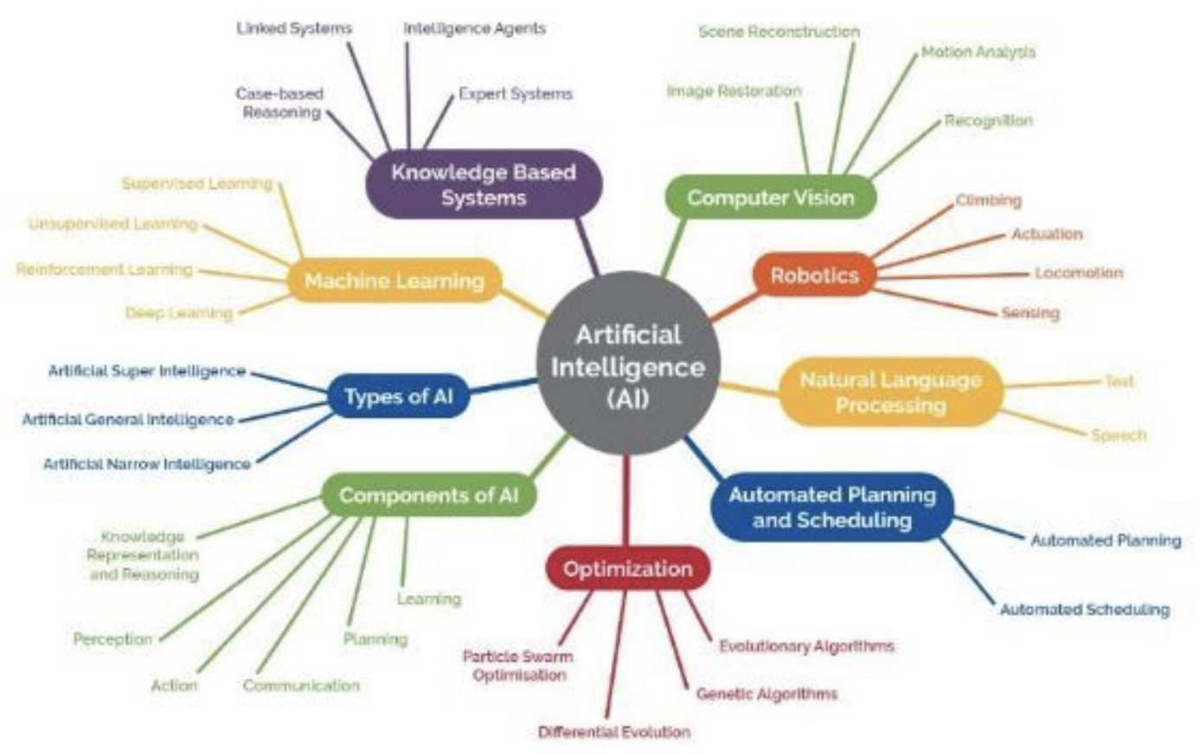
Artificial Intelligence

Slide 4
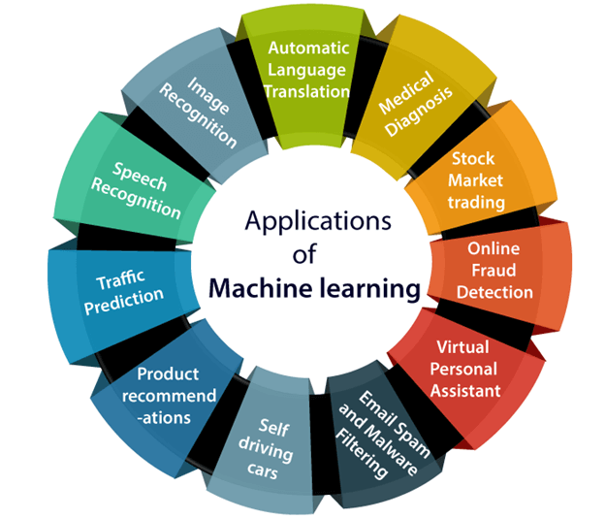
Applications

Slide 5
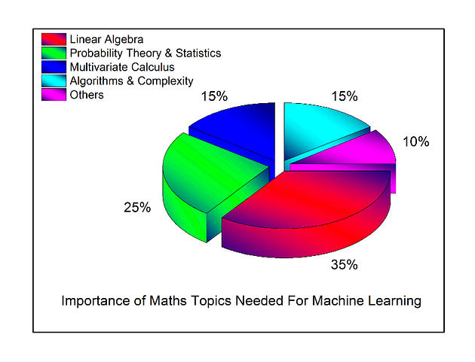
Math topics

Slide 6
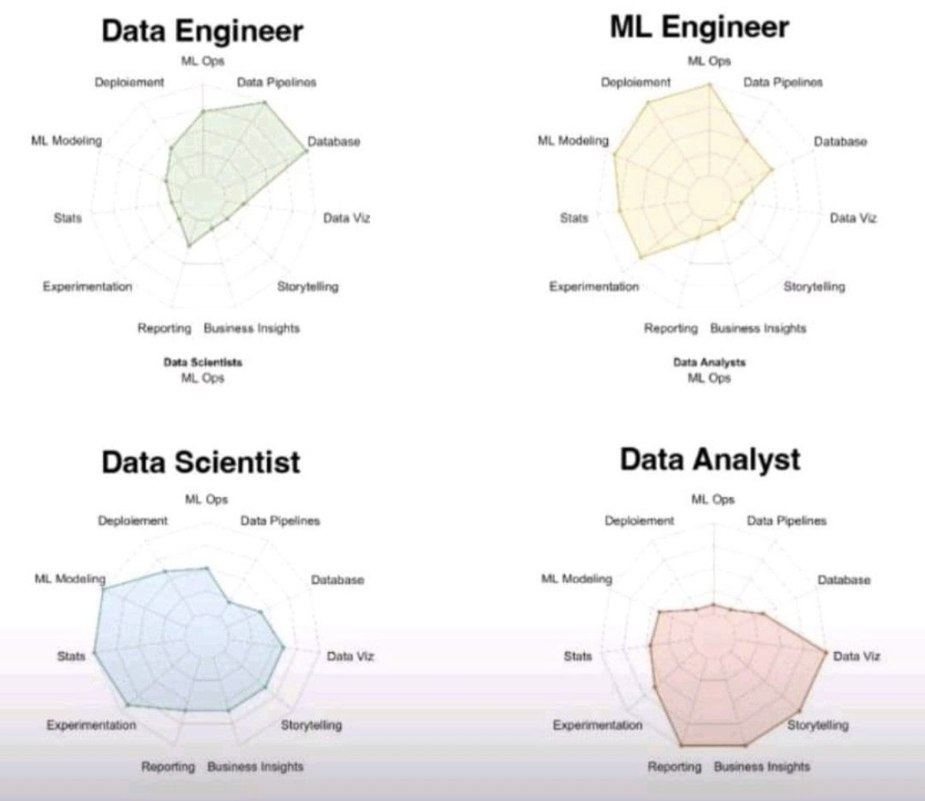
Data Professionals

Slide 7
ML Lifecycle process

Slide 8

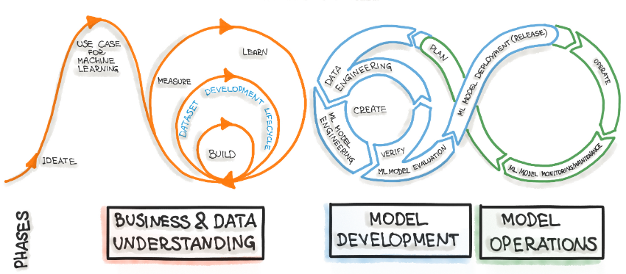
CRISP-ML(Q)

Slide 9
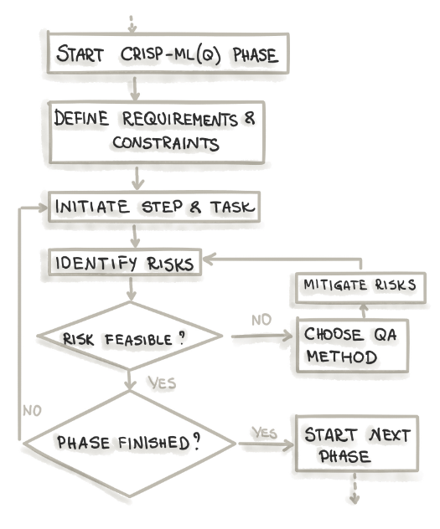
Phases
Business and Data Understanding
Data Engineering (Data Preparation)
Machine Learning Model Engineering
Quality Assurance for
Machine Learning Applications
Deployment
Monitoring and Maintenance

Slide 10
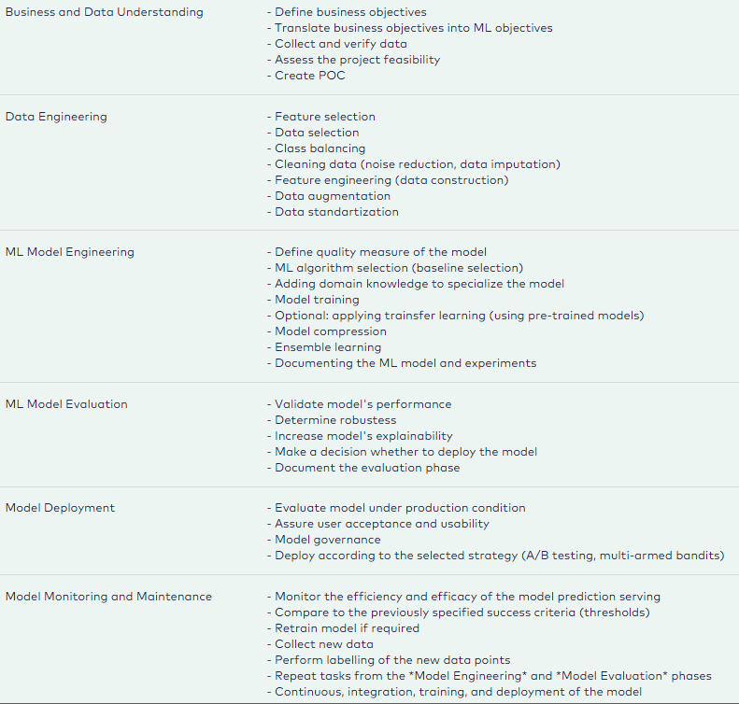
Tasks

Slide 11
ML Data Engineering

Slide 12
Characteristics of data
Data in the real world is dirty
Incomplete – lacking attributes values, attributes of interest or only containing aggregate data
Noisy – containing errors or outliers
Inconsistent – containing discrepancies in codes or names
No quality data means no quality results
Quality decisions can only be based on quality data

Slide 13
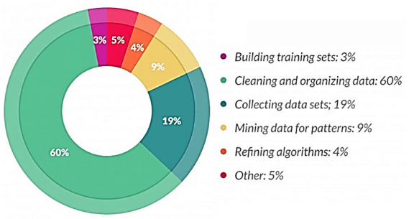
Tasks
Data duplication – removal of duplicated observations
Dimensionality reduction – find projection that captures observations
Encoding – transform data so that it can be consumed by the modeling methods
Missing data – delete, estimate, ignore and replace observations
Noise reduction – remove unwanted or clean up polluted observations
Outliers – identifying observations that do not fit the others
Feature selection – remove redundant or irrelevant attributes
Sampling – find a representative subset
Transformation – map attribute values/objects into a single attribute value/object

Slide 14
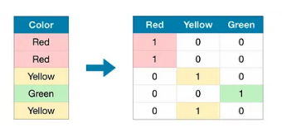
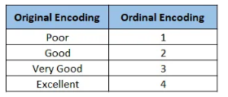
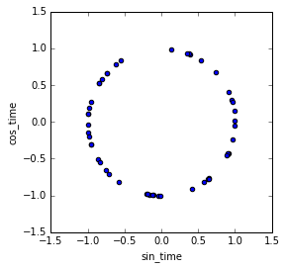
Encoding
Nominal
Ordinal
Cyclical continuous

Slide 15

Data imputation
Missing data – data is not always available
Ignore the subject
Fill in the missing value manually or use a global constant
Use the attribute mean to fill in the missing value
Use the attribute mean for all subjects of the same class
Predict the missing value with the most probable value

Slide 16
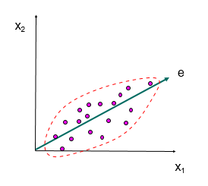
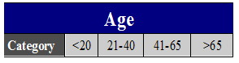
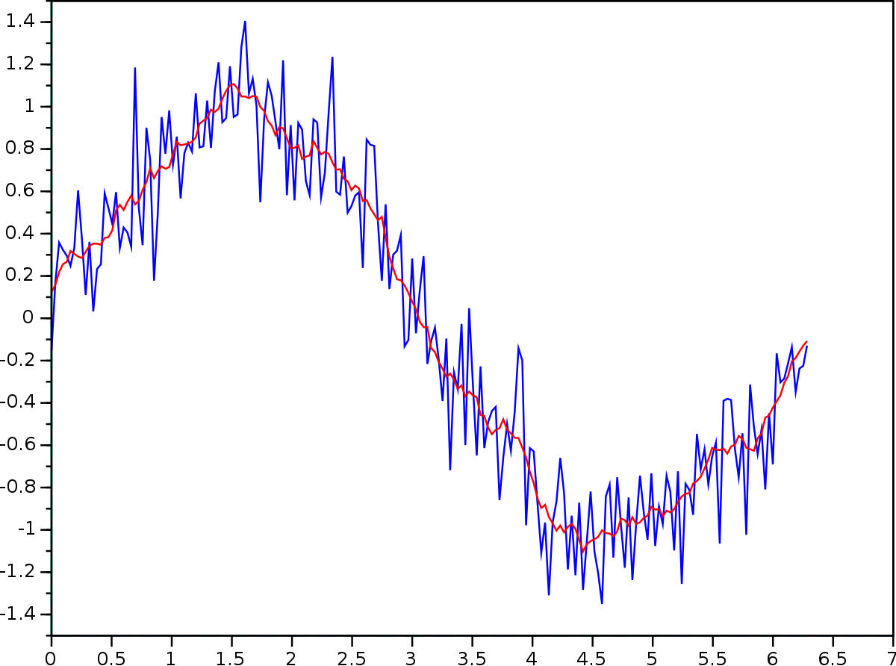
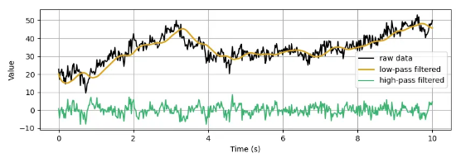
Noise reduction
Binning
Regression
Moving averages
Filters

Slide 17
Signal processing
Filters are designed to selectively modify or extract specific frequency components from a signal while attenuating others
Low-pass filter: Allows low-frequency components to pass through while attenuating higher frequencies. It is useful for removing high-frequency noise or extracting the slow-changing trends from a signal.
High-pass filter: Allows high-frequency components to pass through while attenuating lower frequencies. It is used to remove low-frequency noise or isolate fast-changing features in a signal.
Band-pass filter: Allows a specific range of frequencies to pass through while attenuating others. It is employed when you want to isolate a specific band of frequencies from a signal.
Notch filter: Attenuates a narrow band of frequencies, often used to remove specific interference or noise components.
Different filter designs may be suitable for different scenarios.

Slide 18
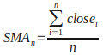
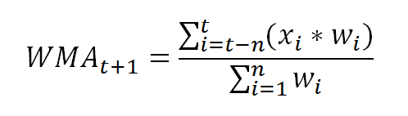
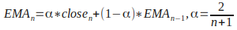
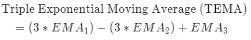
Moving averages
Moving averages are a form of smoothing technique that calculates the average of a subset of adjacent data points within a time series. A "window" or "kernel" of fixed size moves along the data, and the average value within the window is computed at each position.
Noise reduction: By averaging out nearby data points, moving averages can suppress high-frequency noise or fluctuations, resulting in a smoother representation of the underlying signal.
Trend and momentum analysis: Moving averages can help identify trends, momentum and patterns in data by smoothing out short- and longer-term fluctuations. Different types of moving averages, such as simple moving averages (SMA), weighted moving averages (WMA), and exponential moving averages (EMA), provide varying emphasis on recent versus older data points.
Forecasting: Moving averages can be used to generate predictions or forecasts by extrapolating the smoothed trend. They are often employed in time series analysis and financial markets to make short-term predictions.
Different window sizes may be suitable for different scenarios.

Slide 19
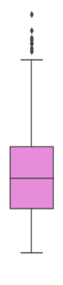
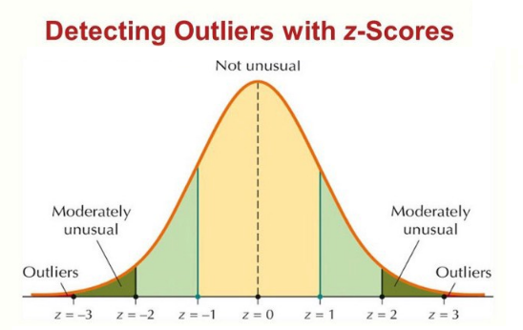
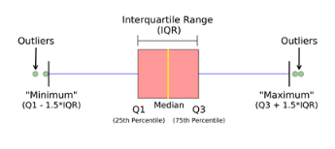

Outlier detection

Slide 20
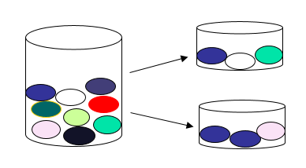
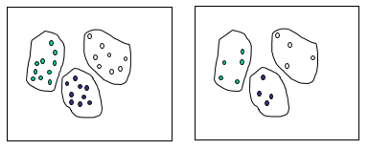
Sampling
Random sampling
Stratified sampling

Slide 21
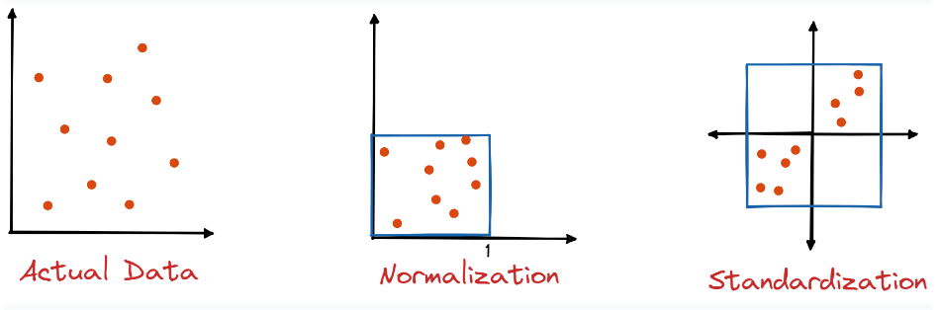
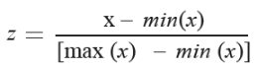
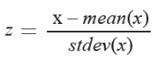
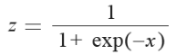
Normalization and Standardization

Slide 22
ML Model Engineering

Slide 23
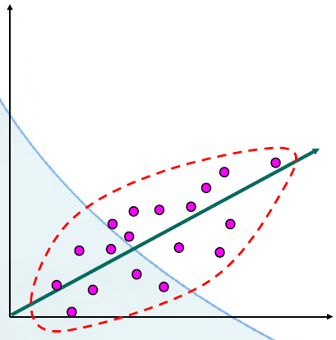
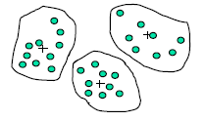
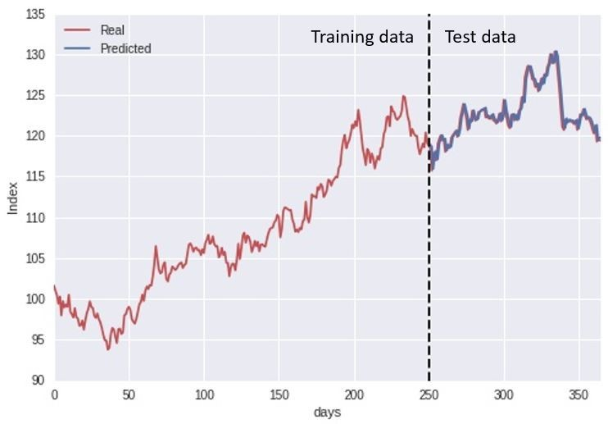
Supervised Learning
Regression – assessing the relationship between traits
in the data and calculates how much a variable changes
when any other variables change
Classification – identify new occurrences
which category it belongs to based on known
observations
Time series – predicting future values based on historical data

Slide 24
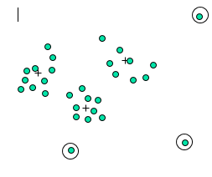
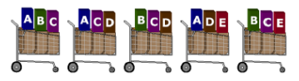
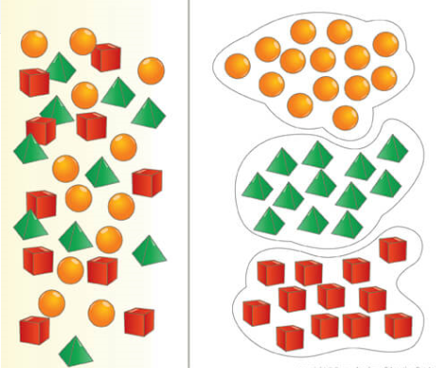


Unsupervised Learning
Outlier detection – detecting occurrences which
fall outside the norm
Association rules – searching and identifying
dependencies, relationships or orders between
features in the data
Clustering – grouping occurrences which have common properties
Sentiment analysis – measuring of the sentiment
Dimensionality reduction – compresses the data that encapsulates the original data

Slide 25
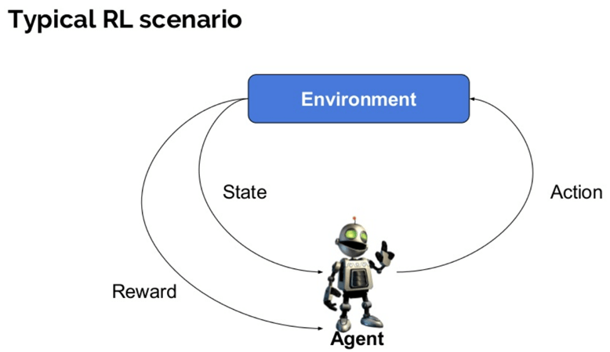
Reinforcement Learning
Model-free
Model-based
Policy Optimization
Q-Learning
Learn the Model
Given the Model

Slide 26
Learning
The analysis of data for discovering meaningful new correlations, patterns and trends by building models (representations of reality) using machine learning (statistical or artificial intelligence) techniques.
ML Algorithm
Training
dataset
Learn
Model
Test
dataset
Apply
Induction (predictive + descriptive models) – The process of reasoning in which the premises of an argument are believed to support the conclusion but do not ensure it.
Deduction (only predictive models) – The kind of reasoning in which the conclusion is necessitated by, or reached from, previously known facts (the premises)

Slide 27
ML Algorithms

Slide 28
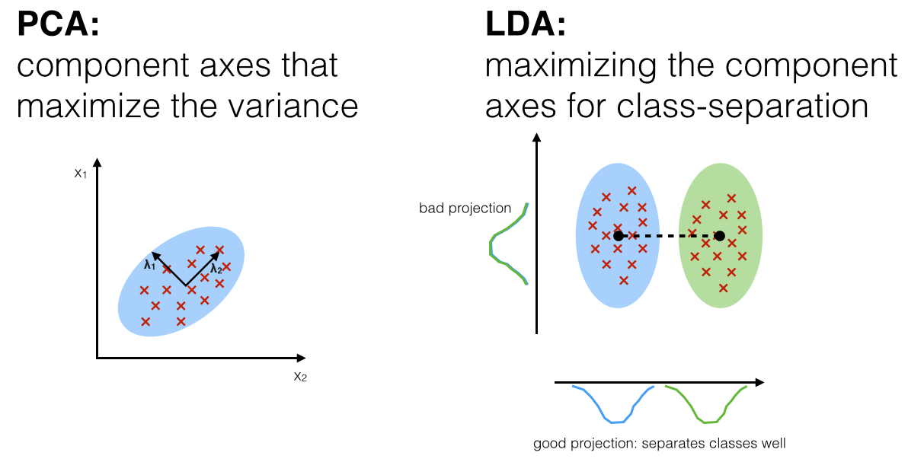
Dimensionality reduction
Principal Component Analysis (PCA) is an unsupervised learning technique that aims to maximize the variance of the data along the principal components
Linear discriminant analysis (LDA) is a supervised learning technique that aims to maximize the separation between different classes in the data
PCA is unsupervised and focuses on maximizing variance, while LDA is supervised and focuses on maximizing class separation
PCA doesn't require labeled data, but LDA does
PCA reduces dimensionality by projecting data onto a lower-dimensional space, while LDA creates linear combinations of features
PCA outputs principal components that capture variation, while LDA outputs discriminant functions that separate classes
PCA is commonly used for exploratory data analysis, while LDA is often used for classification tasks
PCA is generally faster and more computationally efficient, but LDA may be more effective with labeled data

Slide 29
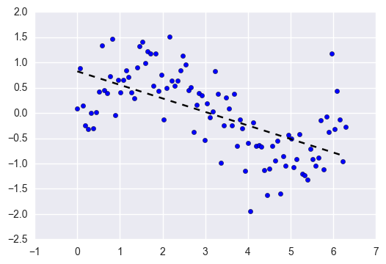
Linear Regression
Linear regression is a statistical technique that models the relationship between a dependent variable and one or more independent variables by fitting a straight line to the data
Benefits | Drawbacks
works well when there are linear relationships between the variables in your dataset | performs poorly when there are non-linear relationships
straightforward to understand and explain | often outclassed by its regularized counterparts
can be updated easily with new data

Slide 30
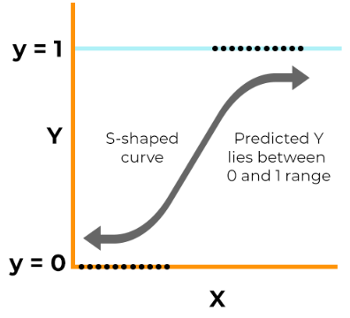
Logistic Regression
Logistic regression is a statistical technique used to model the relationship between a binary dependent variable and one or more independent variables by estimating the probability of the dependent variable belonging to a certain category
Benefits | Drawbacks
easy to implement, interpret, and efficient in training | may lead to overfitting if the number of observations is fewer than the number of features
flexible and does not assume specific class distributions | constructs linear boundaries and assumes linearity between the dependent and independent variables
can handle multiple classes and provides a probabilistic view of predictions | limited to predicting discrete functions and is not suitable for non-linear problems
measures predictor importance and direction of association | requires low or no multicollinearity among independent variables
quickly classifies unknown records and performs well with linearly separable datasets | may struggle to capture complex relationships

Slide 31
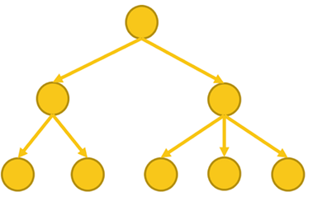
Decision Tree
A decision tree in machine learning is a hierarchical model that uses a sequence of binary splits based on input features to make predictions or classify data
Benefits | Drawbacks
require less effort for data preparation during pre-processing compared to other algorithms | prone to instability
normalization of data is not necessary | calculation more complex
scaling of data is not required | higher training time
missing values in the data have minimal impact | relatively expensive
decision tree is intuitive and easy to explain | primarily designed for predicting discrete or categorical values rather than continuous values

Slide 32
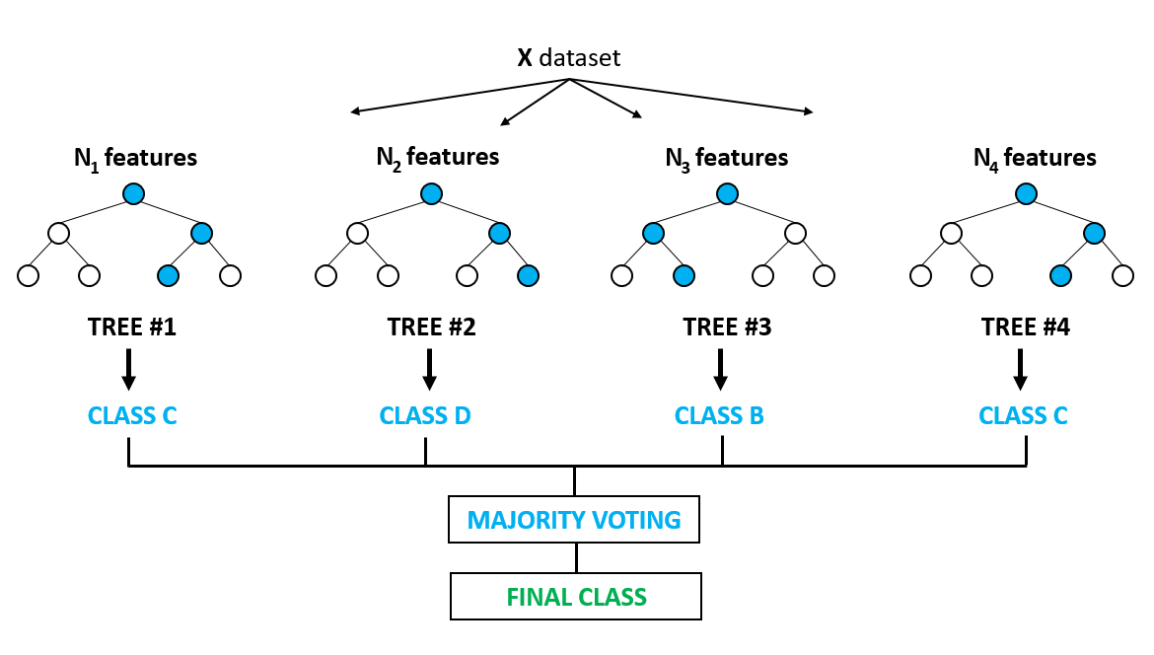
Random Forest
Random Forest combines the output of multiple decision trees to reach a single result to make predictions or classify data
Benefits | Drawbacks
Versatile and easy to use | Computationally demanding
Handles high-dimensional spaces | Model interpretability
Feature importance | Overcomplexity
Robust to overfitting | Bias in multiclass problems
Out-of-box predictor | Lack of precision

Slide 33
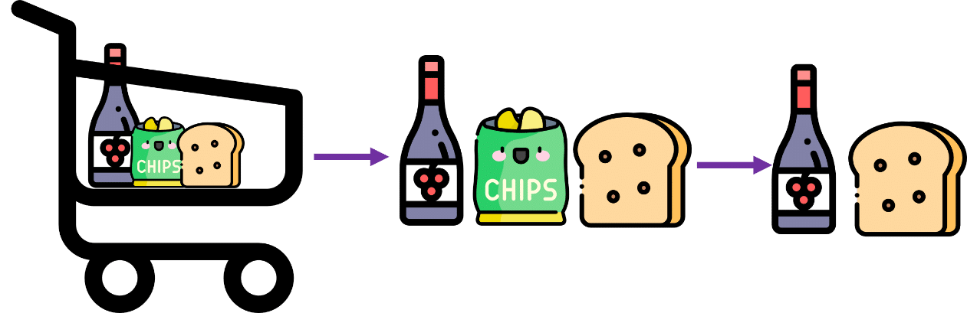
Apriori algorithm
The Apriori algorithm finds frequent patterns and associations in a transactional dataset
Benefits | Drawbacks
Simplicity and ease of implementation | Computational complexity
The rules are human-readable | Difficulty handling sparse data
Flexible and customisable | Limited discovery of complex patterns
The algorithm is widely used and studied | Bias of minimum support threshold
 | Inability to handle numeric data

Slide 34
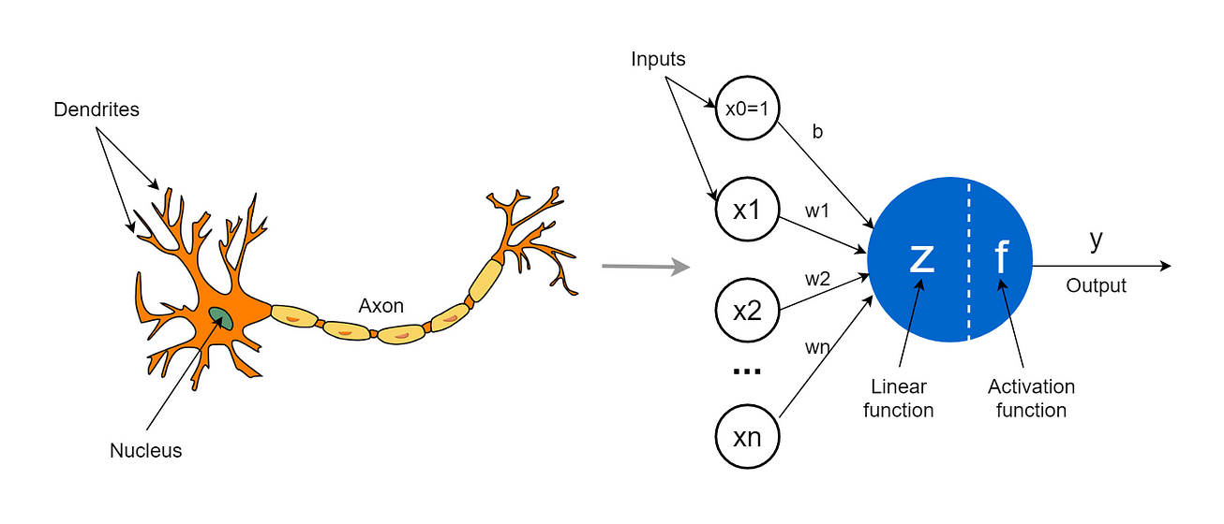
Neural network
A neural network in machine learning is a computational model inspired by the structure and function of the human brain, composed of interconnected nodes or "neurons" that process and transmit information to make predictions or classify data
Benefits | Drawbacks
have several advantages over traditional algorithms | complex and require a significant amount of data to train
can learn from data and tackle complex problems | overfitting is a concern
can generalize and identify patterns that traditional algorithms may miss | lack interpretability
particularly useful for tasks like image recognition and natural language processing | less suited for reasoning or decision-making
are efficient at processing large amounts of data with speed and accuracy | lack explanatory capabilities

Slide 35
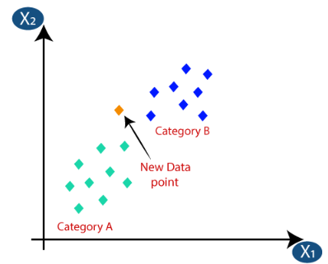
K-Nearest Neighbor
The k-nearest neighbor algorithm is a machine learning algorithm that classifies new data points based on the majority vote of their k nearest neighbors in the training data
Benefits | Drawbacks
simple to implement | needs to determine the value of k
robust to the noisy training data | computation cost is high
can be more effective if the training data is large

Slide 36
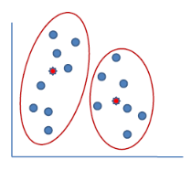
K-Means
The K-means algorithm is a clustering technique that aims to partition data points into k distinct clusters based on their similarity, where each data point is assigned to the cluster with the nearest mean value
Benefits | Drawbacks
relatively easy to implement and apply | determining the optimal value of k
can handle large datasets effectively | dependence on initial values can impact the results of k-means clustering
guarantees convergence to a final solution | clustering data with varying sizes and density can be challenging
allows for warm-starting, initializing centroids with predefined positions | outliers can affect the clustering results
can easily adapt to new examples and generalize to clusters of different shapes and sizes | scalability of k-means is influenced by the number of dimensions in the data

Slide 37
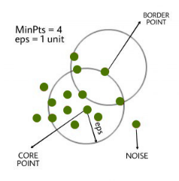
DBSCAN
The DBSCAN (Density-Based Spatial Clustering of Applications with Noise) algorithm is a density-based clustering algorithm that groups data points based on their density and identifies outliers as noise.
Benefits | Drawbacks
Handles irregularly shaped and sized clusters | Not suitable for datasets with categorical features
Robust to outliers | Requires a drop in density to detect cluster borders
Does not require the number of clusters to be specified | Struggles with clusters of varying density Sensitive to scale of variables
Less sensitive to initialization conditions | Sensitive to scale of variables
Relatively fast compared to other clustering algorithms | Performance tends to degrade in high-dimensional data

Slide 38
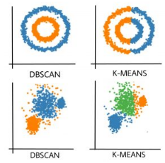
Difference DBSCAN and K-Means
DBSCAN | K-Means
In DBSCAN we need not specify the number of clusters | K-Means is very sensitive to the number of clusters so it need to be specified
Clusters formed in DBSCAN can be of any arbitrary shape | Clusters formed in K-Means are spherical or convex in shape
DBSCAN can work well with datasets having noise and outliers | K-Means does not work well with outliers data, ouliers can skew the clusters in K-Means to a very large extent
In DBSCAN two parameters are required for training the model | In K-Means only one parameter is required for training the model

Slide 39
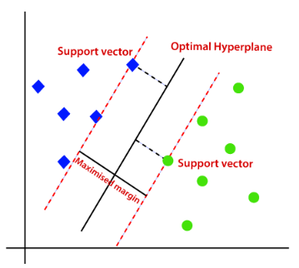
Support Vector Machine
The Support Vector Machine (SVM) algorithm is a supervised learning algorithm that separates data points by finding the optimal hyperplane with the largest margin between different classes
Benefits | Drawbacks
works better when the data is linear | choosing a good kernel is not easy
more effective in high dimensions | doesn’t show good results on a big dataset
can solve any complex problem with kernel trick | not that easy to fine-tune the hyper-parameters
not sensitive to outliers
can do image classifications

Slide 40
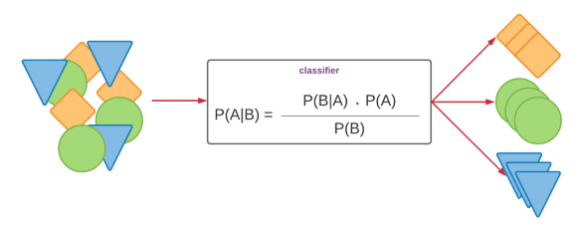
Naive Bayes
The Naive Bayes algorithm is a simple probabilistic classifier that calculates the probability of a data point belonging to a certain class based on the conditional probabilities of its features
Benefits | Drawbacks
works quickly and can save a lot of time | assumes that all predictors (or features) are independent
suitable for solving multi-class prediction problems | faces the ‘zero-frequency problem’
can perform better than other models and requires much less training data | estimations can be wrong in some cases
better suited for categorical input variables than numerical variables

Slide 41
ML Model Evaluation

Slide 42



Bias-Variance Tradeoff
There is a tradeoff between a model's ability to minimize bias and variance

Slide 43




Cross Validation
Hold out
Random subsampling
simplicity and lack of bias
larger population necessary
under certain circumstances bias can occur
Simple and easy to use
Not enough test data for a sparse dataset
Error rate misleading when unfortunate split
K-Fold
Leave one out
less biased on test data
computational costs
stable accuracy
prevents overfitting
model Generalization Validation
imbalanced dataset
computational costs

Slide 44



Walk Forward Optimization
Walk Forward Analysis does optimization on a training set; test on a period after the set and then rolls it all forward and repeats the process.
Walk Forward Matrix is a set of walk forward analysis with different number of periods
and out of sample percentages

Slide 45



Regression Metrics

Slide 46






Classification Metrics
A confusion matrix visualizes and summarizes the performance of a classification algorithm

Slide 47




Associations Metrics
This says how popular an itemset is, as measured by the proportion of transactions in which an itemset appears
The support of {apple} is 4 out of 8, or 50%
This says how likely item Y is purchased when item X is purchased, expressed as {X -> Y}
The confidence of {apple -> beer} is 3 out of 4, or 75%
This says how likely item Y is purchased when item X is purchased, while controlling for how popular item Y is
The lift of {apple -> beer} is 3 out of 4 multiplied by 6, or 12,5%

Slide 48

References
Akinfaderin, W. (2021, April 30). The Mathematics of Machine Learning - Towards Data Science. Medium. https://towardsdatascience.com/the-mathematics-of-machine-learning-894f046c568
AlgoDaily. (n.d.). AlgoDaily - Daily coding interview questions. Full programming interview prep course and software career coaching. https://algodaily.com/lessons/standardization-and-normalization
Anindya. (2022). Naive Bayes algorithm in Machine Learning with Python. ThinkInfi. https://thinkinfi.com/naive-bayes-algorithm-in-machine-learning-with-python/
Applications of Machine Learning - Javatpoint. (n.d.). www.javatpoint.com. https://www.javatpoint.com/applications-of-machine-learning
Baheti, P. (2023, April 24). What is Machine Learning? The Ultimate Beginner's Guide. V7. https://www.v7labs.com/blog/machine-learning-guide
Butler, R. G. (2017, May 22). Preparing your Data for AutoDiscovery: Table-Like Structure in Excel. butlerscientifics. https://www.butlerscientifics.com/single-post/2017/05/22/preparing-your-data-for-autodiscovery-table-like-structure-in-excel
Chauhan, A. (2021, December 31). Random Forest Classifier and its Hyperparameters - Analytics Vidhya - Medium. Medium. https://medium.com/analytics-vidhya/random-forest-classifier-and-its-hyperparameters-8467bec755f6
Descriptive Predictive Prescriptive Analytics | Data Science Association. (n.d.). https://www.datascienceassn.org/content/descriptive-predictive-prescriptive-analytics
Editor. (2021, October 30). Data Scientist vs Data Engineer: Differences and Why You Need Both. AltexSoft. https://www.altexsoft.com/blog/data-scientist-vs-data-engineer/
Ehlers, J. (2005), Building Trading Systems on Nonlinear Filters
EliteDataScience. (2022, July 8). Modern Machine Learning Algorithms: Strengths and Weaknesses. EliteDataScience. https://elitedatascience.com/machine-learning-algorithms
Ellis, C. (2022, June 8). When to use DBSCAN. Crunching the Data. https://crunchingthedata.com/when-to-use-dbscan/
Encoding cyclical continuous features - 24-hour time. (2016, July 31). Ian London’s Blog. https://ianlondon.github.io/blog/encoding-cyclical-features-24hour-time/
GeeksforGeeks. (2023). Advantages and Disadvantages of Logistic Regression. GeeksforGeeks. https://www.geeksforgeeks.org/advantages-and-disadvantages-of-logistic-regression/

Slide 49
References
GeeksforGeeks. (2023b). DBSCAN Clustering in ML Density based clustering. GeeksforGeeks. https://www.geeksforgeeks.org/dbscan-clustering-in-ml-density-based-clustering/
Goyal, C. (2021). Importance of Cross Validation: Are Evaluation Metrics enough? Analytics Vidhya. https://www.analyticsvidhya.com/blog/2021/05/importance-of-cross-validation-are-evaluation-metrics-enough/
Han, J., Kamber, M., & Pei, J. (2012). Data mining: concepts and techniques. Choice Reviews Online, 49(06), 49–3305. https://doi.org/10.5860/choice.49-3305
K, D. (2023, February 7). Top 5 advantages and disadvantages of Decision Tree Algorithm. Medium. https://dhirajkumarblog.medium.com/top-5-advantages-and-disadvantages-of-decision-tree-algorithm-428ebd199d9a
k-Means Advantages and Disadvantages. (n.d.). Google for Develop
K-Nearest Neighbor(KNN) Algorithm for Machine Learning - Javatpoint. (n.d.). www.javatpoint.com. https://www.javatpoint.com/k-nearest-neighbor-algorithm-for-machine-learning
Kumar, A. (2023, April 13). PCA vs LDA Differences, Plots, Examples - Data Analytics. Data Analytics. https://vitalflux.com/pca-vs-lda-differences-plots-examples/#:~:text=PCA%20is%20an%20unsupervised%20learning,directions%20of%20maximum%20class%20separability
Kumar, A. (n.d.). AN INTRODUCTION TO MARKET BASKET ANALYSIS - ASSOCIATION RULE. www.linkedin.com. https://www.linkedin.com/pulse/introduction-market-basket-analysis-association-rule-abhishek-kumar
Lecture 12: Bias Variance Tradeoff. (n.d.). https://www.cs.cornell.edu/courses/cs4780/2018fa/lectures/lecturenote12.html
Likebupt. (2021, November 4). Normalize Data: Component Reference - Azure Machine Learning. Microsoft Learn. https://learn.microsoft.com/en-us/azure/machine-learning/component-reference/normalize-data?view=azureml-api-2
Mitchell, C. (2022). Triple Exponential Moving Average (TEMA): Definition and Formula. Investopedia. https://www.investopedia.com/terms/t/triple-exponential-moving-average.asp
ml-ops.org. (2023, February 22). https://ml-ops.org/content/crisp-ml
Ohseokkim. (2021). [Preprocessing] Encoding Categorical Data. Kaggle. https://www.kaggle.com/code/ohseokkim/preprocessing-encoding-categorical-data
Part 2: Kinds of RL Algorithms — Spinning Up documentation. (n.d.). https://spinningup.openai.com/en/latest/spinningup/rl_intro2.html

Slide 50
References
Pramoditha, R. (2022, January 3). The Concept of Artificial Neurons (Perceptrons) in Neural Networks. Medium. https://towardsdatascience.com/the-concept-of-artificial-neurons-perceptrons-in-neural-networks-fab22249cbfc
R, G. S. (2022, October 21). Encoding Categorical Data- The Right Way - Towards AI. Medium. https://pub.towardsai.net/encoding-categorical-data-the-right-way-4c2831a5755
Ricardo Gutierrez-Osuna, Lecture 13: Cross-validation, http://www.cs.tau.ac.il/~nin/Courses/NC05/pr_l13.pdf
RoboticsBiz. (2022). Pros and cons of Random Forest Algorithm. RoboticsBiz. https://roboticsbiz.com/pros-and-cons-of-random-forest-algorithm/
SagarDhandare. (2022, March 28). Nominal And Ordinal Encoding In Data Science! - Nerd For Tech - Medium. Medium. https://medium.com/nerd-for-tech/nominal-and-ordinal-encoding-in-data-science-c93872601f16
Saini, A. (2023). Support Vector Machine(SVM): A Complete guide for beginners. Analytics Vidhya. https://www.analyticsvidhya.com/blog/2021/10/support-vector-machinessvm-a-complete-guide-for-beginners/
Seraydarian, L. (2023). What Is a Confusion Matrix in Machine Learning? Plat.AI. https://plat.ai/blog/confusion-matrix-in-machine-learning/
Sumanth, G. (2021, December 12). Illustrative Example of Principal Component Analysis(PCA) vs Linear Discriminant Analysis(LDA): Is PCA good guy or bad guy ? Medium. https://medium.com/analytics-vidhya/illustrative-example-of-principal-component-analysis-pca-vs-linear-discriminant-analysis-lda-is-105c431e8907
Understanding stratified cross-validation. (n.d.). Cross Validated. https://stats.stackexchange.com/questions/49540/understanding-stratified-cross-validation
Vadapalli, P. (2022). Naive Bayes Explained: Function, Advantages & Disadvantages, Applications in 2023. upGrad Blog. https://www.upgrad.com/blog/naive-bayes-explained/#:~:text=Naive%20Bayes%20is%20suitable%20for,input%20variables%20than%20numerical%20variables.
Walk-Forward Matrix - StrategyQuant. (2021, August 10). StrategyQuant. https://strategyquant.com/doc/strategyquant/walk-forward-matrix/
What is Machine Learning? | IBM. (n.d.). https://www.ibm.com/topics/machine-learning#:~:text=the%20next%20step-,What%20is%20machine%20learning%3F,learn%2C%20gradually%20improving%20its%20accuracy
Wikipedia contributors. (2023). Cross-validation (statistics). Wikipedia. https://en.wikipedia.org/wiki/Cross-validation_%28statistics%29
Wikipedia contributors. (2023b). Walk forward optimization. Wikipedia. https://en.wikipedia.org/wiki/Walk_forward_optimization#:~:text=Walk%20Forward%20Analysis%20does%20optimization,Pardo

